Slide 1

Pre-final Demonstration

Slide 2
Your goal
Fully automatic music composer
User friendly GUI or guide page for abcnotion

Slide 3
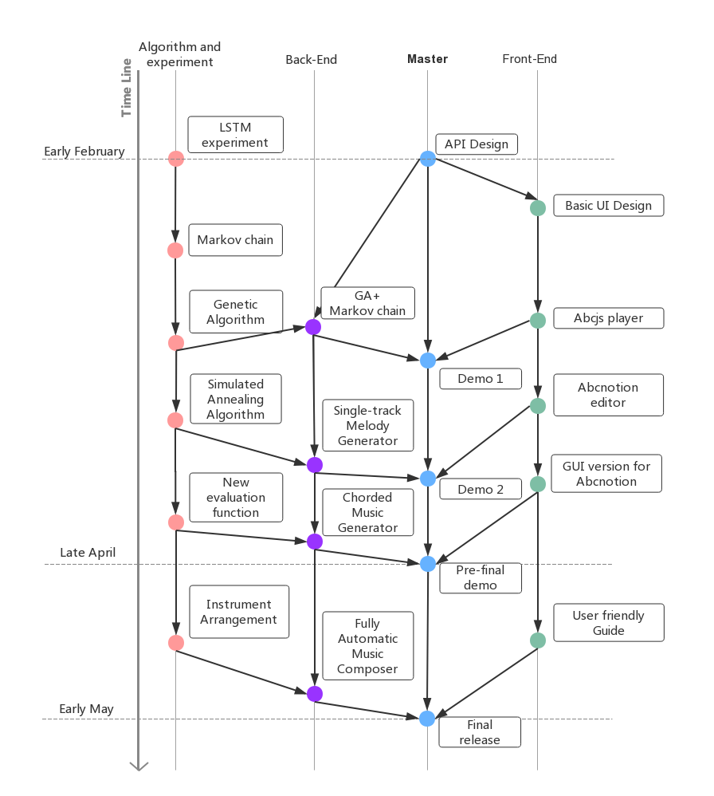
Your SE CycleLife
The things you did for each step
How did you organize the whole project

Slide 4
Individual contribution
Mo Fan: Algorithm design and Backend development
Li Kengjie: Frontend development
Zhang Ruoqing: UI design and art design
Ye Shuian: Product manager and documentation
Wang Junce: API design and documentation

Slide 5
Pre-demonstration
To run it (it is allowed to show a captured video)
Show more use cases

Slide 6
The Problems & Solutions
(last month)
1.Different standard for music representation
Solution: using abcnotion standard as interface
2.For the property of GA model, last bar ends in established note is not guaranteed.
Solution: add a pre-defined gene with established ending.
3.From single track to multiple tracks:
Solution: a dynamic programming is applied to generate chord
4.Blocking wait in GUI:
Solution: asynchronous requests

Slide 7
Your plan for next two weeks
Let the program compose not only melody but also instrument arrangement. A novel algorithm must be applied on it. If possible, add velocity performance to output a wav file.
A user-friendly guide for abcnotion. No matter it’s a document page or interactive guide.

Slide 8
Notes
Presentation Order is the same as previous
10 mins for each group with 2 mins Q&A
Bring papers to write comments for presenters

